Slide 1

EXAM Details

Slide 2
Foundation of Software Development and Software Testing Theoretical 1 - Introduction
2025/2026 I. Semester
Levente_Varga1@epam.com
CONFIDENTIAL | © 2025 EPAM Systems, Inc.

Slide 3
Phase I.
Introduction
SDLC Models, Agile Tools
Phase II.
Phase III.
Fundamentals of RQ engineering and Software Architecture
Fundamentals of testing
Test Design Techniques
Test Automation Tools
Test Management
AI Basics
Static Techniques
UML in practice
Test Levels and Types
CONFIDENTIAL | © 2025 EPAM Systems, Inc.

Slide 4
Phase I.
Sprint planning, Estimation in practice
Jira, Workflow presentation, CI
Phase II.
Phase III.
Building Requirements
Black Box Testing techniques pt1
Black Box Testing techniques pt2
Code Analysis with tools
Real life project presentation 2
Creating UML
Test Case implementation
Real life project presentation 1
CONFIDENTIAL | © 2025 EPAM Systems, Inc.

Slide 6

Who We Are
EPAM
EPAM is a leading global provider of digital platform engineering and development services.
We serve a diverse and global list of clients across 11 industries, from 55+ countries.
Among our clients are some of the world's foremost brands across all major industries. Of our top 100 clients, 67 are in the Fortune 500 or Forbes Global 2000.
52,650+*
Employees globally
55+*
Countries
3
Offices in Hungary: Budapest, Debrecen, Szeged
*Based on Q2 2024 data
CONFIDENTIAL | © 2025 EPAM Systems, Inc.

Slide 7
Jumpstart Your Career with EPAM Campus

Slide 8

What Do We Offer?
EPAM CAMPUS
The EPAM Campus programs are online, free courses that can be completed with a flexible schedule, online.
Diverse content
Mentors support
Top-notch materials
Industry-based education
Levels, from 0 to hero:
Basic
Beginner
Fundamentals
Specialization
Learn more at epa.ms/campus-programs or in the 'EPAM Képzési Programok' Facebook group.
CONFIDENTIAL | © 2025 EPAM Systems, Inc.

Slide 9
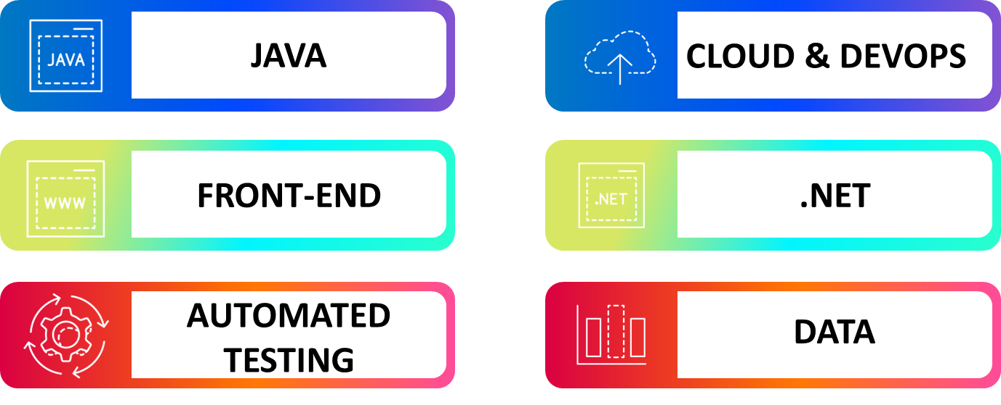
EPAM CAMPUS
Areas of Education

Slide 10
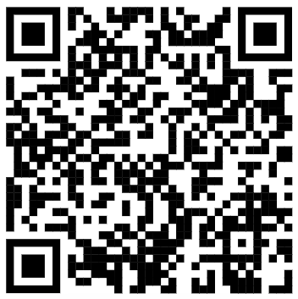
What tech job is right for you? Fill out this quiz and find out!
EPAM CAMPUS
Find Your Path in IT

Slide 11

Stay in Touch
EPAM
Facebook:
EPAM Hungary
EPAM Képzési Programok (group)
Instagram
@epam_hungary
Blog, podcast
Life In Tech
CONFIDENTIAL | © 2025 EPAM Systems, Inc.

Slide 12






Developers at EPAM - https://careers.epam.hu
​
Development / JavaScript
Development / Java
Frontend
Backend
Contact: WFATalentAcquisitionDebrecen@epam.com
CONFIDENTIAL | © 2025 EPAM Systems, Inc.

Slide 13

Quality Assurance at EPAM - https://careers.epam.hu
Testing / Software Testing Engineer
Testing / Software Quality Engineer
SET / Software Test Automation Engineer
SET / Software Engineer in Test
Contact: WFATalentAcquisitionDebrecen@epam.com
CONFIDENTIAL | © 2025 EPAM Systems, Inc.

Slide 14


Typical QA Specialist Jobs
Functional
Automation
Cloud
Performance
Accessibility
Mobile
Security
Manager
Auditor
…
CONFIDENTIAL | © 2025 EPAM Systems, Inc.

Slide 15


Tech Stack
ISTQB – CTFL, CTAL, CTEL
https://www.istqb.org/
https://www.istqb.org/certifications/certified-tester-foundation-level
https://www.istqb.org/certifications/certification-list/
Company Specific Frameworks
Jira, Confluence, Test Management tools (e.g. qTest, TestRail)
Java 8+, JS, Python, .NET
Selenium, Cucumber, WebDriver
GitLab, GitLab CI, Bamboo CI, Bitbucket
CONFIDENTIAL | © 2025 EPAM Systems, Inc.

Slide 16
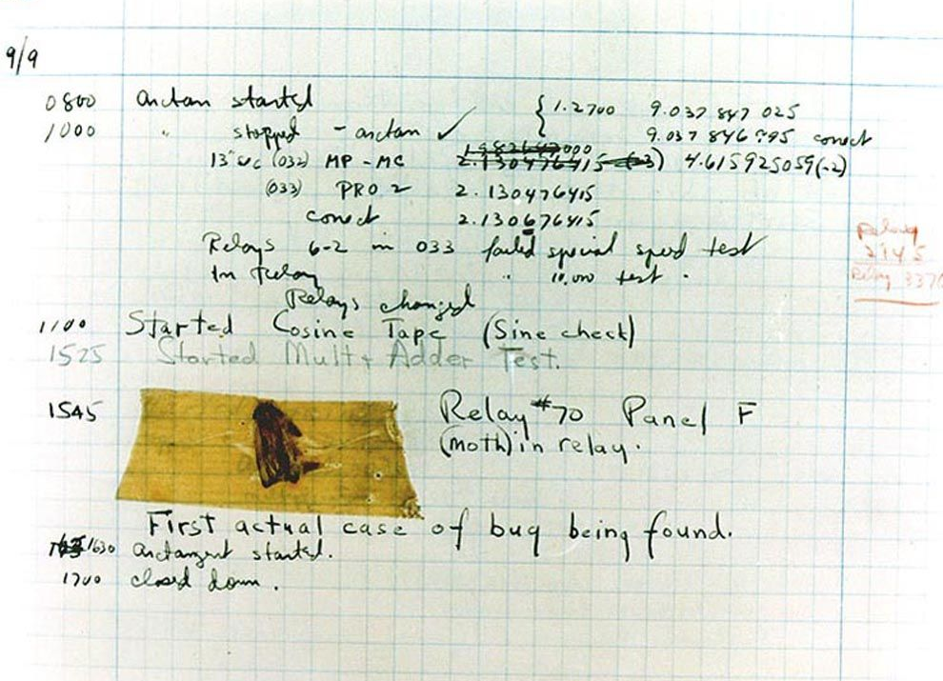
First Bug
Sep 9, 1947
Grace Hopper?
William "Bill" Burke?
Moth
Term comes from Edison
Consistent, Reproducible
Debugging
Pretty well documented ticket
CONFIDENTIAL | © 2025 EPAM Systems, Inc.

Slide 17

Other interesting bugs
Fighter plane altitude bug
McDonalds – 0$ Hamburger bun
Playstation Message brick
Y2K bug
Windows 98 BSOD
PSN Security breach
Xbox Kinect bug
CrowdStrike
ChatGPT Grandma Jailbreak
CONFIDENTIAL | © 2025 EPAM Systems, Inc.

Slide 18
Questions?
CONFIDENTIAL | © 2025 EPAM Systems, Inc.

Slide 19
Thank you for your attention! Levente_Varga1@epam.com
CONFIDENTIAL | © 2025 EPAM Systems, Inc.

